Slide 1
Custom Directives
Name : K . Sathwik
Roll. No : 22H51A0533
Branch : CSE-D

Slide 2
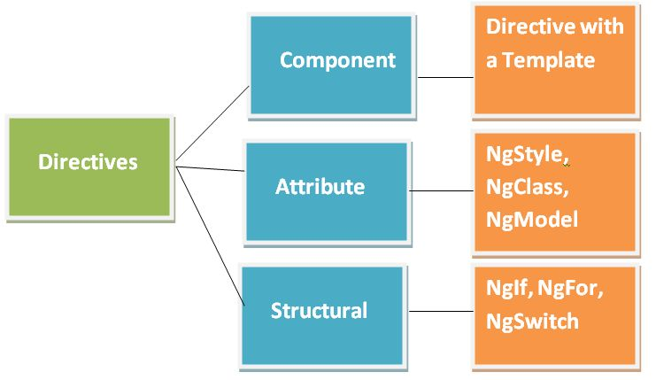
Introduction to Custom Directives
Custom directives in Angular provide a mechanism to create reusable components and add behavior to HTML elements. They help to encapsulate complex functionality, apply dynamic behavior, and enhance the structure of the DOM.
Understanding custom directives enhances flexibility and maintainability in applications.
Notes:
Image source: https://tutorialstrend.com/tutorials/angular/angular-directives

Slide 3
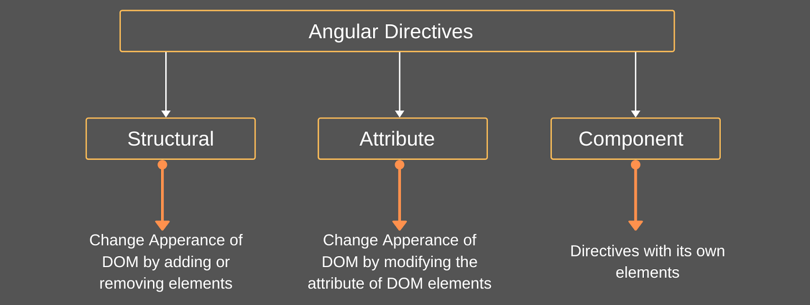
What are Directives?
Directives are special markers in the DOM that tell the library or framework to do something.
They can manipulate the DOM structure, behavior, or appearance based on specified conditions.
Custom directives extend the functionality of built-in directives, providing tailored solutions.
Notes:
Image source: https://www.coreprogramm.com/2020/04/angular-directives.html

Slide 4
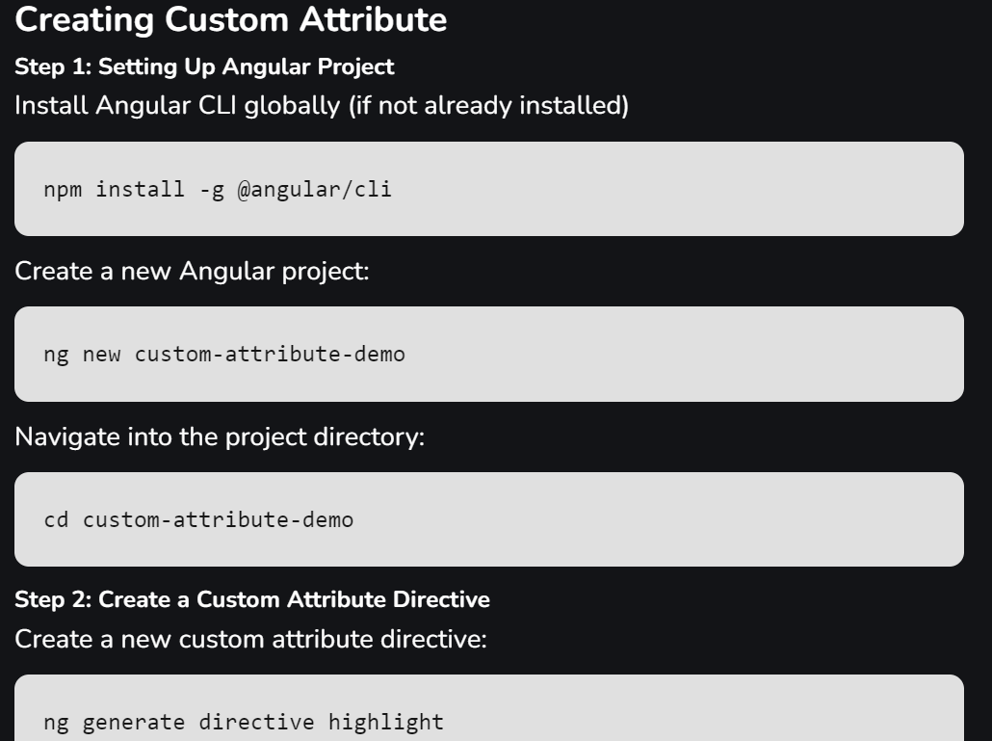
Creating a Custom Directive
You will specify the directive's behavior and how it interacts with the DOM.
Most frameworks require you to register the directive before using it in your application.
They can encapsulate complex logic that can be reused across different parts of an application.
Additionally, they can help with managing third-party libraries and plugins more effectively.
Notes:
Image source: https://briefly.co/anchor/Vue/story/how-to-create-a-custom-attribute-directive-in-angular

Slide 5
Types of Directives
There are three main types of directives: component directives, structural directives, and attribute directives.
Component directives are the most complex and encapsulate both behavior and template.
Structural directives change the DOM layout by adding or removing elements.
Attribute directives change the appearance or behavior of existing elements.
Notes:
Image source: https://www.tatvasoft.com/outsourcing/2023/06/directives-in-angular.html

Slide 6
Features of Custom Directives
Encapsulation of Behavior: Custom directives encapsulate specific functionality, provides code reusability and maintainability.
Dynamic Behavior: They enable the application of dynamic behavior to HTML elements based on user interactions, data changes, or application logic.
Access to DOM: Directives can access and manipulate the DOM using Angular’s ElementRef service, providing fine-grained control over the presentation layer.
Reusable Components: Custom directives can be reused across different parts of the application, provides modular development and reducing code duplication.
Notes:
Image source: https://www.tatvasoft.com/outsourcing/2023/06/directives-in-angular.html

Slide 7
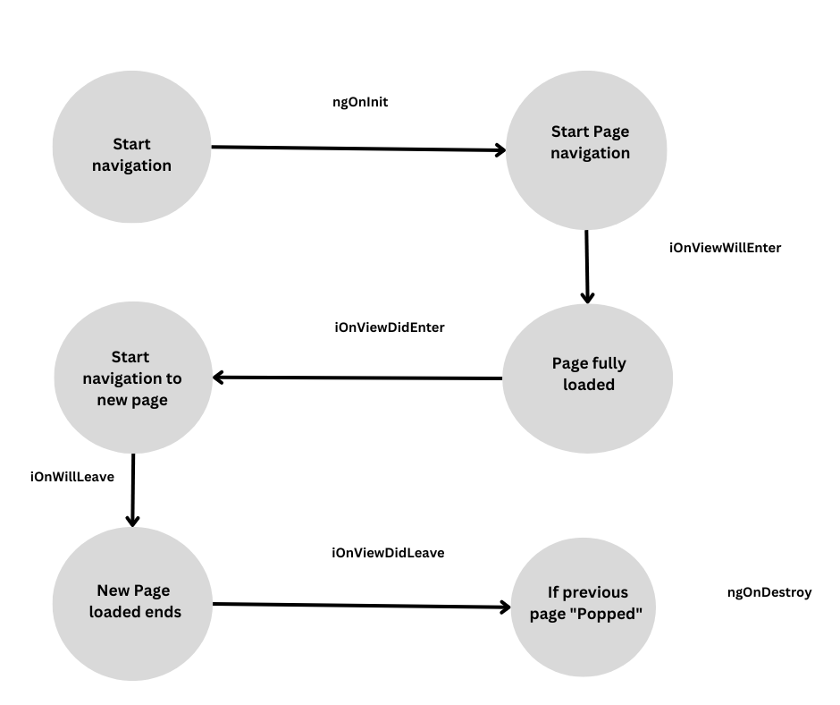
Lifecycle Hooks in Custom Directives
Lifecycle hooks allow you to tap into the directive's lifecycle and manage its behavior.
Common hooks include ngOnInit, ngOnChanges, and ngOnDestroy.
Understanding these hooks helps in effectively managing resources and performance.
Notes:
Image source: https://blog.openreplay.com/lifecycle-hooks-in-angular--a-complete-guide/

Slide 8
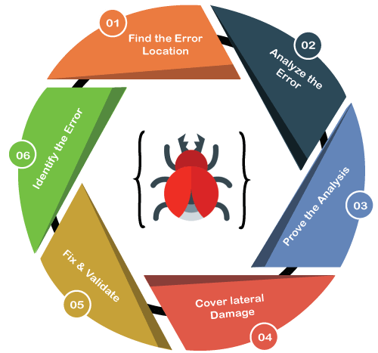
Debugging Custom Directives
Debugging custom directives can involve using browser developer tools to inspect the DOM.
Logging lifecycle hooks can help trace the execution flow of your directives.
Testing frameworks can facilitate unit testing for directive behavior and interactions.
Notes:
Image source: https://www.javatpoint.com/debugging

Slide 9
Conclusion
Custom directives are powerful tools in web development that promote code reusability.
They enhance application performance and maintainability when used correctly.
Notes:
Image source: https://www.semanticscholar.org/paper/Software-Reusability:-Approaches-and-Challenges-Anasuodei-Ojekudo/2e0180a4d899f7b1f304b30b5a6be9ee69b5997d

Slide 10
THANK YOU
Notes:
Image source: https://djcordhose.github.io/javascript-web-frameworks/2015_lehmanns_web_frameworks.html

